Slide 1

NLP and Word Embeddings
Using word embeddings
deeplearning.ai

Slide 2

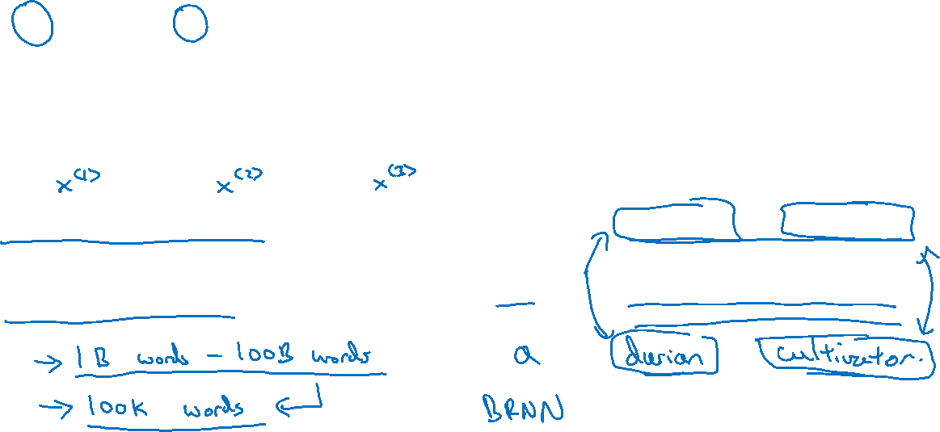



Named entity recognition example
$$1$$
$$1$$
$$0$$
$$0$$
$$0$$
$$0$$
Sally Johnson is an orange farmer
Robert Lin is an apple farmer

Slide 3
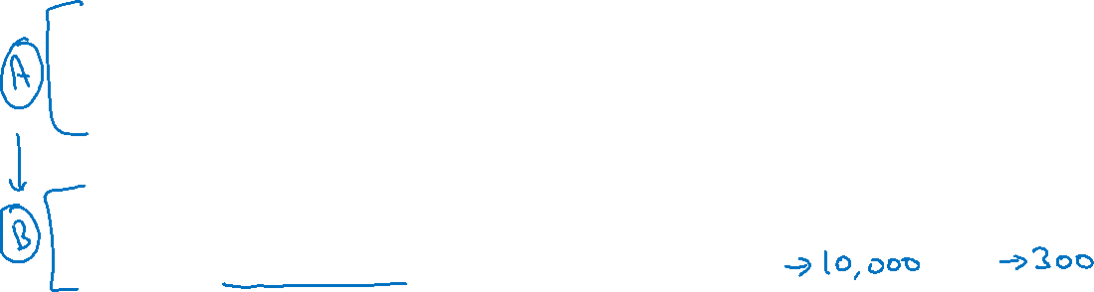
Transfer learning and word embeddings
Learn word embeddings from large text corpus. (1-100B words)
(Or download pre-trained embedding online.)
2. Transfer embedding to new task with smaller training set.
(say, 100k words)
3. Optional: Continue to finetune the word embeddings with new
data.

Slide 4
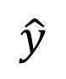

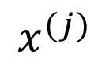


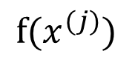
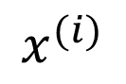
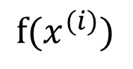
Relation to face encoding
$$⋮$$
$$x^{(i)}$$
$$f(x^{(i)})$$
$$\hat{y}$$
$$⋮$$
$$⋮$$
$$x^{(j)}$$
$$f(x^{(j)})$$
[Taigman et. al., 2014. DeepFace: Closing the gap to human level performance]

